Slide 1


Olfactory Sabha
f
Project 2: EEG
Alaa - Aliaa -Fatma Elzahraa - ToQa-Mohammed
TA: Tarek

Slide 2
Introduction
This project was completed as part of the "Introduction to Computational Neuroscience" summer course by Arab Neuroscience. The focus of the project is on building a classification model for motor imagery using (EEG) recorded signals, a technique used in brain-computer interfaces (BCIs).
Motor imagery involves the mental simulation of movement, engaging brain regions related to actual motor tasks without physical execution. This model aims to accurately classify motor imagery signals, contributing to advancements in neurorehabilitation and assistive technologies for individuals with motor impairments.

Slide 3
Objectives
Investigate the activity of specific EEG electrodes that are closely correlated to actual or imagined hands movement.
Build a model able to perform classification between left and right hand movement.
Build a model able to classify between either left or right motor imagery and rest state
Build model able to classify between actual and imaginary hand movements, for example (left MI) and (left real)

Slide 4
Data:
EEG Data Set Overview
Total Recordings: 1,500+ EEG recordings (1-2 minutes each)
Participants: 109 volunteers
64-channel EEG were recorded using the BCI2000 system
subject performed 14 experimental runs:
Baseline, eyes open
Baseline, eyes closed
Task 1 (open and close left or right fist)
Task 2 (imagine opening and closing left or right fist)
Task 3 (open and close both fists or both feet)
Task 4 (imagine opening and closing both fists or both feet)
Repetition: Each task type is repeated 3 times

Slide 5
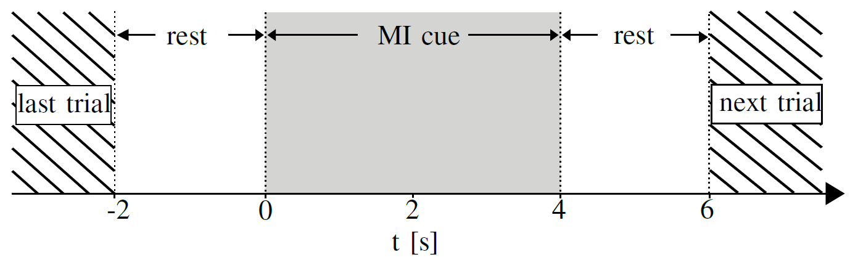
Pipeline of Tasks
Capture EEG signal
Convert Analogue Signal to Digital Signal
Load the data
Classification (LDA)
Feature Extraction
Data Preprocessing & filtering & create epochs
8-11 Hz for mu rhythms
Fitting & testing the classifier
Model Deployment in a specific application
Epoching
Notes:
1. Capture EEG Signal
EEG signals from the brain using electrodes placed on the scalp ( continuous analog electrical potentials)
2.Convert Analogue Signal to Digital Signal
The captured analog EEG signals need to be converted into digital format using an Analog-to-Digital Converter (ADC)
3. Load the data
Once the signals are digitized, they are loaded into a computer for further processing using MNE
4. Data Preprocessing & filtering & create epochs
cleaning the data to remove noise, artifacts (like eye blinks, muscle movements), and unwanted frequencies.
Filtering: Applying filters (e.g., band-pass filters to focus on specific frequency ranges, such as 8-12 Hz for mu rhythms).
Create Epochs: Segmentation of continuous data into smaller, time-locked segments (epochs) around specific events of interest (e.g., motor imagery tasks).
5.Feature Extraction
Extract meaningful features from the preprocessed data. For motor imagery tasks for example, common spatial patterns (CSP).
6.Classification (LDA)
Apply a machine learning algorithm, such as Linear Discriminant Analysis (LDA), to classify the extracted features into predefined categories (e.g., left-hand vs. right-hand movement).
7. Fitting & testing the classifier
Train the classifier on a subset of data and test it on another to evaluate its performance (e.g., using cross-validation) to ensure that the classifier generalizes well to new, unseen data.

Slide 6
Results

Slide 7
Feature Extraction via Common Spatial Patterns (CSP):
(CSP) is a method used in signal processing, particularly in EEG analysis, to extract features that help differentiate between two classes of data.
CSP works by:
Maximizing Variance: CSP finds spatial filters that maximize the variance of one class of signals (e.g., left-hand movement) while minimizing the variance of the other class (e.g., right-hand movement). Variance in EEG signals is often linked to power, which relates to brain activity.
Spatial Filters: The method produces a set of spatial filters that can be applied to the EEG data. When applied, these filters project the original signals into a new space where the differences between the classes are more pronounced.

Slide 8
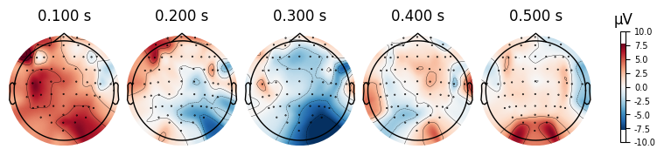
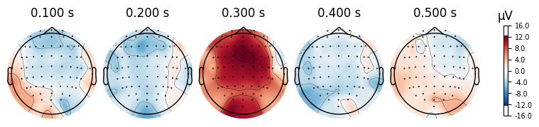
Motor imagery: visualization of left hand (T1) vs right hand (T2)

Slide 9
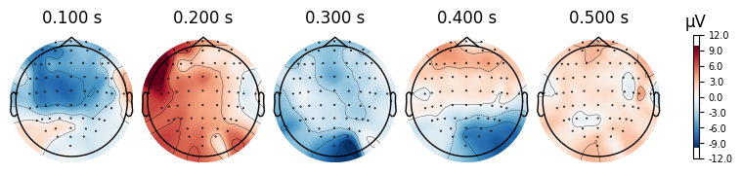
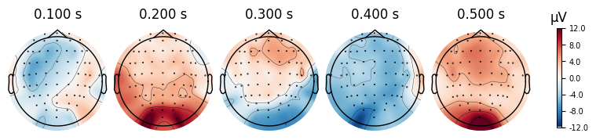
Motor Execution: visualization of left hand (T1) vs right hand (T2)

Slide 10
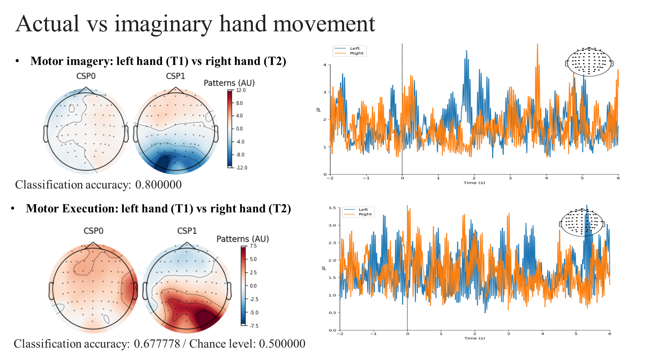
Average of evoked response in time domain

Slide 11
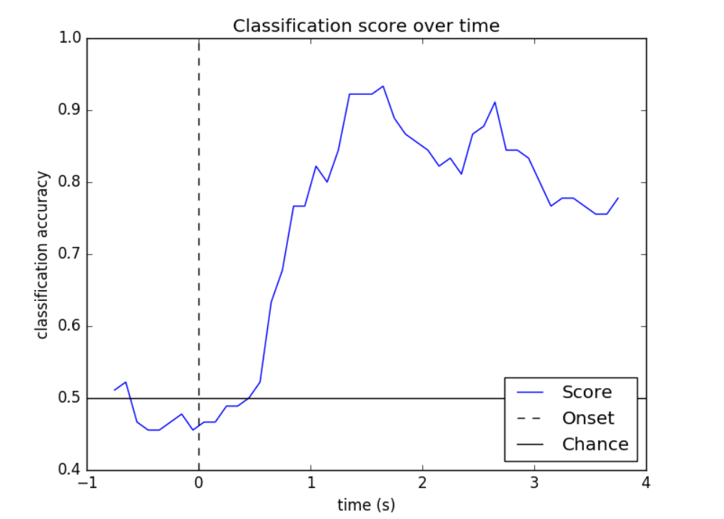
Classification with Linear Discriminant Analysis (LDA)
The plot displays how brain activities impact the model's performance over time and identifies the periods when the model is most effective at distinguishing between different activities.

Slide 12
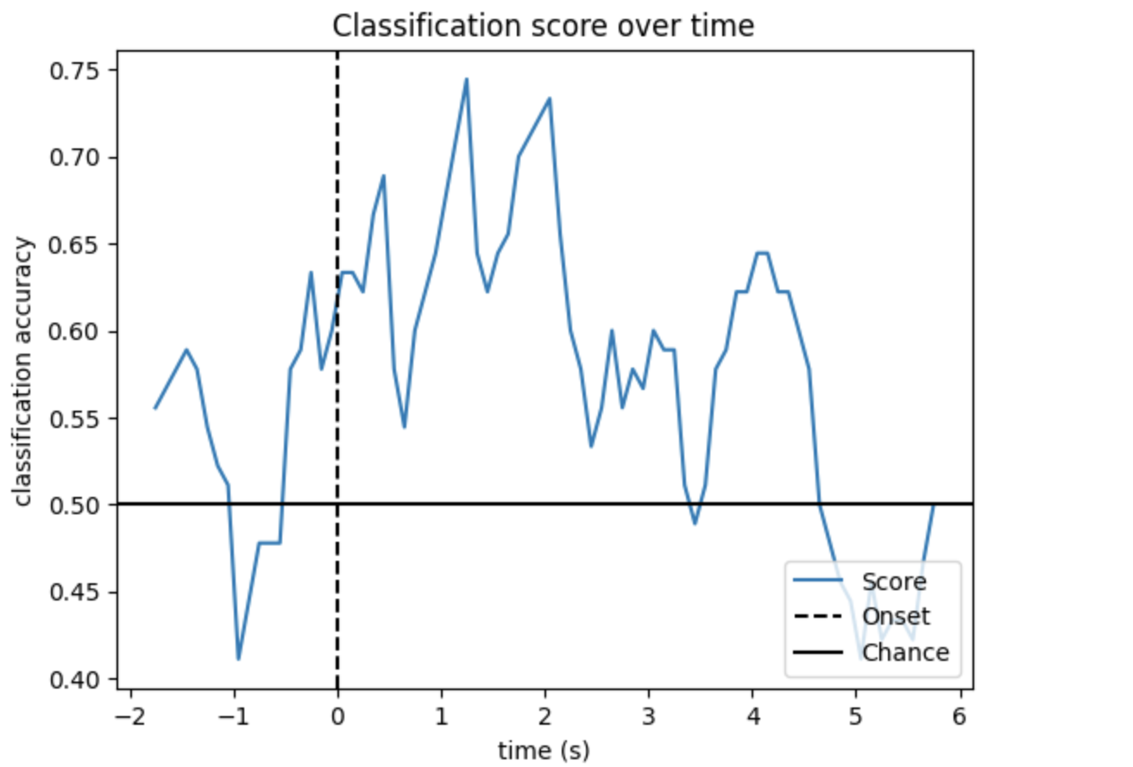
Classification models algorithms
Linear Discriminant Analysis (LDA) algorithm to build the classification model.
Model 1: Classification between left and right hand movements(MI)
Accuracy=80%

Slide 13
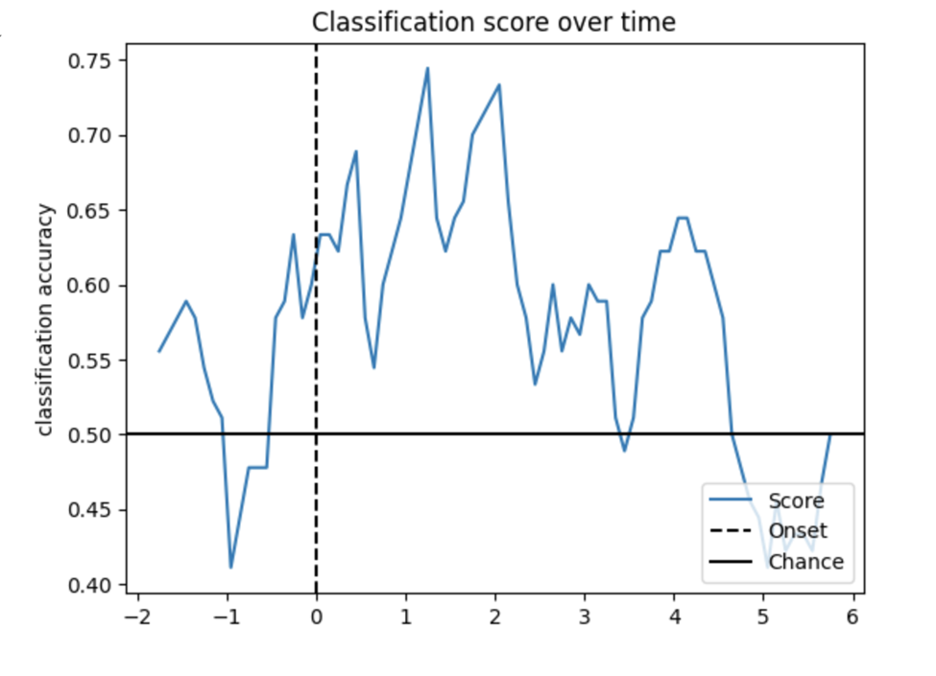
Classification models algorithms
Model 2: Classify between either left or right motor imagery and rest state
Accuracy=31.7%

Slide 14
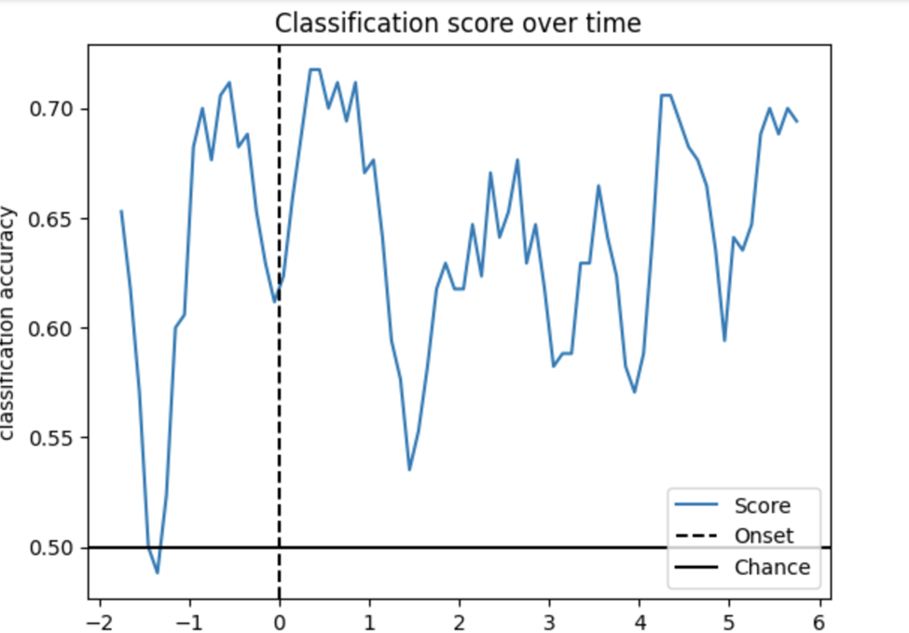
Classification models algorithms
Model 3: Classify between actual and imaginary hand movements, for example (left MI) and (left real)
Accuracy=77%

Slide 15
Reference:
Goldberger, A., Amaral, L., Glass, L., Hausdorff, J., Ivanov, P. C., Mark, R., ... & Stanley, H. E. (2000). PhysioBank, PhysioToolkit, and PhysioNet: Components of a new research resource for complex physiologic signals. Circulation [Online]. 101 (23), pp. e215–e220.
Schalk, G., McFarland, D.J., Hinterberger, T., Birbaumer, N., Wolpaw, J.R. BCI2000: A General-Purpose Brain-Computer Interface (BCI) System. IEEE Transactions on Biomedical Engineering 51(6):1034-1043, 2004.
Tang, Z., Li, C., & Sun, S. (2017). Single-trial EEG classification of motor imagery using deep convolutional neural networks. Optik, 130, 11-18.
Zaky, M. H., Khedr, M. E., & Nasser, A. A. (2016, July). Effect of extensive training load on the classification accuracy for a three class motor imagery based brain-computer interface. In 2016 3rd International Conference on Advances in Computational Tools for Engineering Applications (ACTEA) (pp. 211-215). IEEE.
Notes:
While the beta frequency (typically 13–30 Hz) is also relevant to motor control, especially in tasks involving active movement and motor preparation, the mu frequency is often emphasized in motor EEG studies for several reasons:
Resting State and Motor Imagery: The mu rhythm is prominent during states of relaxed wakefulness and motor imagery (thinking about or planning movements without actual execution). It tends to exhibit clear modulation during motor tasks, making it useful for detecting and analyzing motor intentions.
Motor Execution: The mu rhythm exhibits pronounced desynchronization (decrease in amplitude) when motor activities are planned or executed. This desynchronization is a well-established marker for motor-related brain activity.
Artifact and Noise Considerations: The beta frequency is also involved in motor control but can sometimes be more affected by artifacts or noise related to actual movement and other high-frequency activity. The mu rhythm, being slightly lower in frequency, often provides a clearer signal for motor planning and imagery.
Distinct Features: The mu rhythm and beta rhythm can both provide valuable information, but they reflect different aspects of motor control. The mu rhythm is more sensitive to motor planning and imagery, while beta rhythm is more associated with motor execution and active movement.
In summary, the mu frequency is commonly chosen for its clear association with motor planning and imagery, providing distinct and useful features for analyzing motor-related brain activity.

